Slide 1

Ergonomics Semester 2 Week 1

Slide 2
What had been discussed last week
Review the one-page slide
Check out the datasets
Check out the physical unit of the coordinates

Slide 3
Timeline
Content | Date | Progress
Learning Basics of Deep Learning | Sep 2022 | Done
Installing Alphapose/Openpose | Sep-Oct 2022 | Done
Learning Ergonomics Basics | Oct-Nov 2022 | Done
Forming a Framework of Time Continuous Cumulative Fatigue
Preparing for Final Exam | Nov-Dec 2022 | Done
Review the Time Continuous Cumulative Fatigue Framework | Dec 2022 | Done
Trying to Extract Coordinates Using Alphapose/Openpose | Dec 2022
Adding on a Cumulative Fatigue Assessment using Alphapose/Openpose with Python | Jan-Mar 2023
Writing a Technical Report for our Research | Mar 2023

Slide 4
One-page Slide
Vision_Based_Ergonomic_Cumulative_Risk_Assessment.pptx

Slide 5
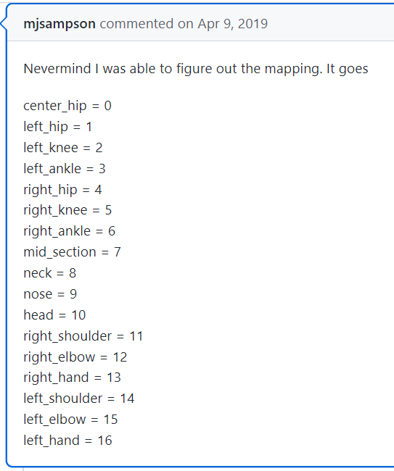
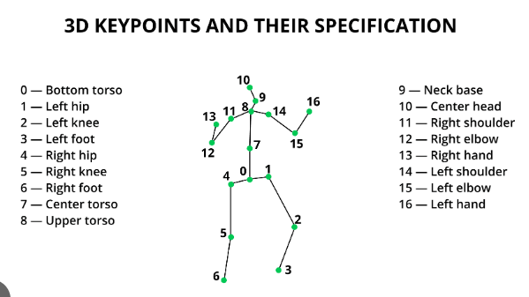
VideoPose3D
1. The corresponding joints of the extracted coordinates are as follows:

Slide 6
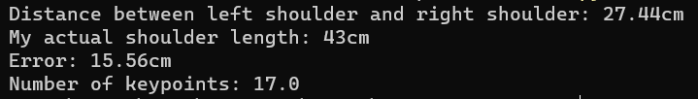
VideoPose3D
The physical unit of the extracted coordinates are in meters, and in camera frame. But we only need distance within body parts, therefore we don’t need to transform to world frame.
Pixel Frame
Image Frame
Camera Frame
World Frame
Discretization
Perspective Projection (Intrinsic Params)
Rigid Transformation (Extrinsic Params)

Slide 7
Challenges of This Week
Modify the one-page slide
Understand what does the extracted coordinates mean (in what frame and correspond to which joint)

Slide 8
Next Meeting
Start designing an algorithm to compute ergonomic cumulative damage

